Slide 1
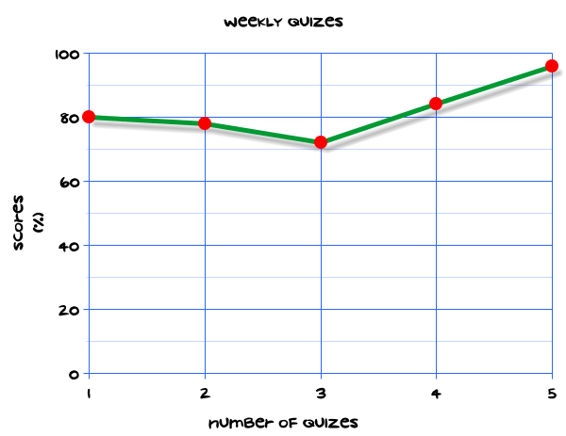
My Statistics Interactive Notebook
Name
Class
Teacher
Term 1 Semester 1
1

Slide 2
Create your own front page
It needs to contain the following –
My number interactive notebook
Name
Class
Teachers Name
Semester 1 Term 1
Page number 1

Slide 3
Contents
Glossary or Formula Page
Page
Date
Description
2
3

Slide 4
Tasks
24
7
30
Essential Question
Questions
Notes
Summary
4
5

Slide 5
24
7
30
Date
Title
EQ –
5

Slide 6
24
7
30
Date
Relationships between bivariate data
EQ –
How do we describe the relationship between bivariate data?
What is bivariate data?
Data where each item has two measurements that can be represented as variables is called bivariate data.
5

Slide 7
24
7
30
Date
Relationships between bivariate data
EQ –
How do we describe the relationship between bivariate data?
What is bivariate data?
Data where each item has two measurements that can be represented as variables is called bivariate data.
What do we use to determine relationships between variables?
A scatter plot of bivariate data has values that are plotted as coordinates. One variable is onthe horizontal axis and the other one is on the vertical axis. It is used to look for relationships
between variables.
5

Slide 8
24
7
30
Date
Relationships between bivariate data
EQ –
How do we describe the relationship between bivariate data?
What is bivariate data?
Data where each item has two measurements that can be represented as variables is called bivariate data.
What do we use to determine relationships between variables?
A scatter plot of bivariate data has values that are plotted as coordinates. One variable is onthe horizontal axis and the other one is on the vertical axis. It is used to look for relationships
between variables.
If the points on a scatter plot lie between sloping parallel lines, you can say that there is a relationship between the variables. If the lines have a positive slope, you say it is a positive relationship, but for a negative relationship they slope down. The variables generally change in the same way in a positive relationship but in opposite ways in a negative relationship.
5

Slide 9
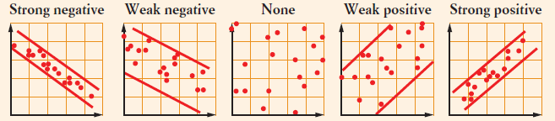
24
7
30
Date
Relationships between bivariate data
EQ –
How do we describe the relationship between bivariate data?
What do we use to determine relationships between variables?
A scatter plot of bivariate data has values that are plotted as coordinates. One variable is onthe horizontal axis and the other one is on the vertical axis. It is used to look for relationships
between variables.
If the points on a scatter plot lie between sloping parallel lines, you can say that there is a relationship between the variables. If the lines have a positive slope, you say it is a positive relationship, but for a negative relationship they slope down. The variables generally change in the same way in a positive relationship but in opposite ways in a negative relationship.
The parallel lines are close together for a strong relationship but are well separated when the relationship is weak.
5

Slide 10
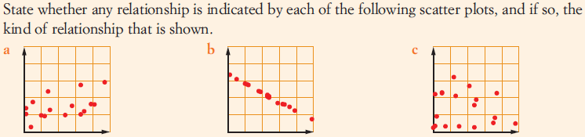
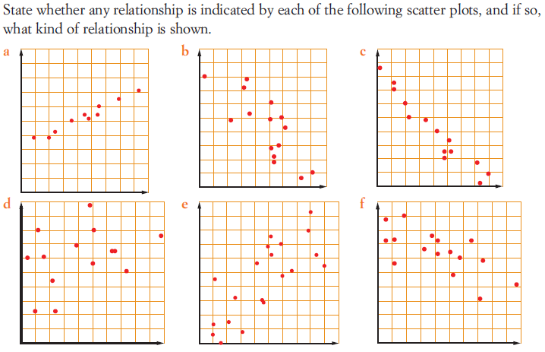
Task

Slide 11
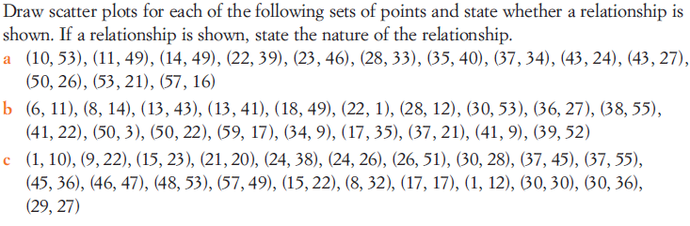
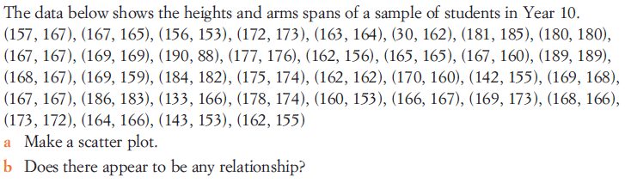
Task

Slide 12
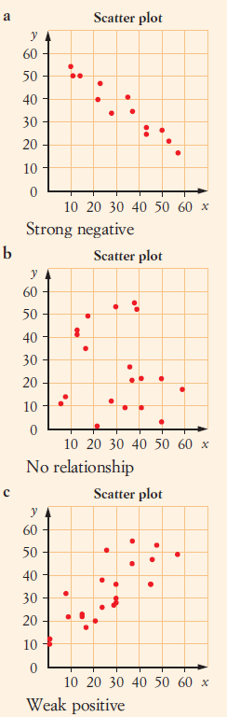
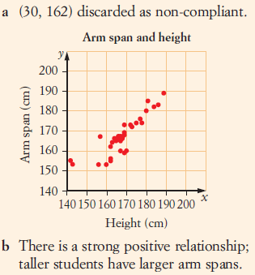
Answers

Slide 13
Notes Review
24, 7 ,30
Date
Title
Essential question
Notes complete
Notes complete with colour and diagrams
Questions completed
Contents page filed in
Formula page filled in

Slide 14
Homework
Review your notes and write a summary answering the essential question.

